Slide 1
RecipeTop: Group 7
Final Presentation
Gera Versfeld, EE Miguel Ramirez, CpE
Edwin Santiago, EE Jason Portillo, CpE

Slide 2
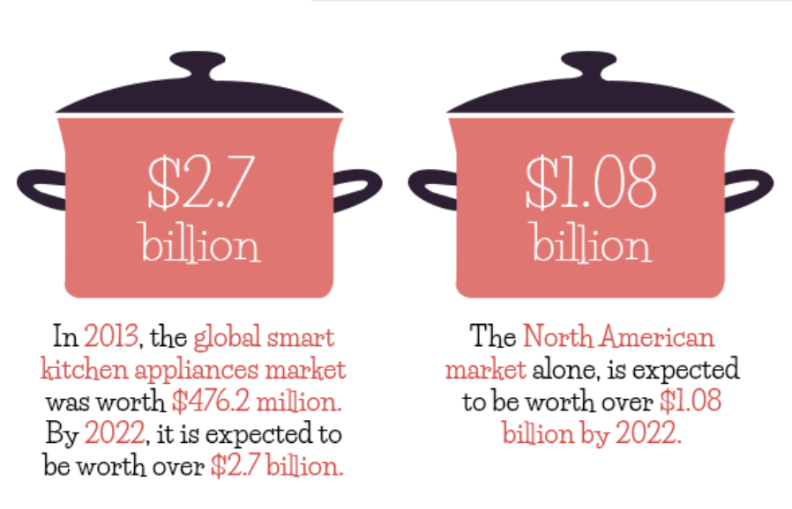
Motivation
Create something that helps people learn to cook
Make cooking a more organized and enjoyable experience
Make the kitchen a more fully integrated part of a modern smart home
-Irma Wallace. “The Smart Kitchen of the Future is Here [Infographic].” Infographic Journal, 22 Feb. 2017, https://infographicjournal.com/the-smart-kitchen-of-the-future-is-here/
Notes:
Miguel
Edwin - Story
How many people here cook while using their phones to look up recipes online? Cooking using online recipes is great because it gives you measurements of the ingredients needed and the step-by-step to complete a delicious meal. But let me give you a scenario. Say you were baking a cake, in the preparation stages, you would probably get your hands full of flour. Now if I want to see what the next step of my recipe is, I need to touch my phones display and smear it with flour and that is what I don’t like about following a recipe with my phone. So we wanted to develop a device that could show us our next step and be cleaned as easily as a countertop.
Miguel-Although we wanted to create something that was going to help someone complete a certain task, we also wanted our project to be practical. As you can see in the graphic , the smart kitchen appliance market is expected to be worth over 2.7 billion dollars in a couple of years.

Slide 3
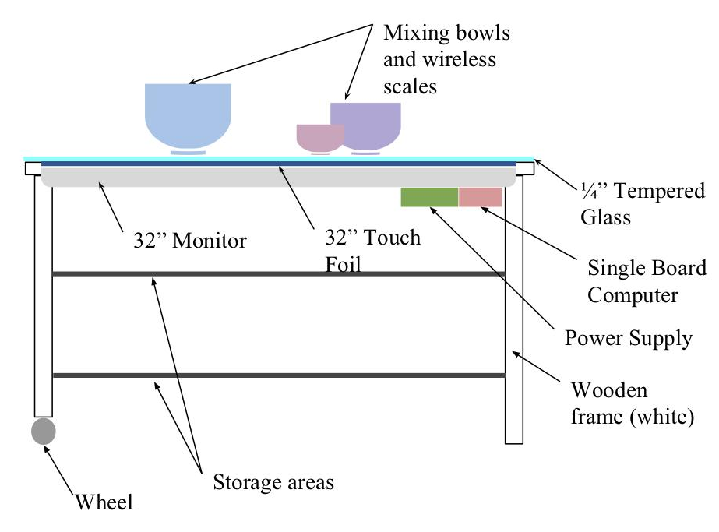

What is RecipeTop?
An interactive countertop and recipe preparation assistant
Notes:
Jason
RecipeTop is an interactive countertop and recipe preparation assistant. It will have a touch screen display surface to allow user to interface with a recipe management application. The application will allow users to browse, create, and execute recipes. Additionally, we will have an integrated wireless scale to enable the users to weigh ingredients for their recipes.

Slide 4
Objectives
Core
Advanced
Stretch
A multi-touch countertop that will provide users with a unique and helpful experience when cooking.
Seamlessly interface your kitchen to make cooking simpler.
We hope to integrate computer vision and ML to for more interactivity and better recipe suggestions.
Multi-touch enabled display
Intuitive user interface
Recipe search, storage, and suggestions
Companion mobile application
Recipe search and suggestion based on ingredients on counter
Integration with smart home products like Alexa or Google Assistant
Wirelessly connected scale
Recipe guidance with clear steps and useful features like timers
Compact design with storage space built in
Notes:
Gera

Slide 5
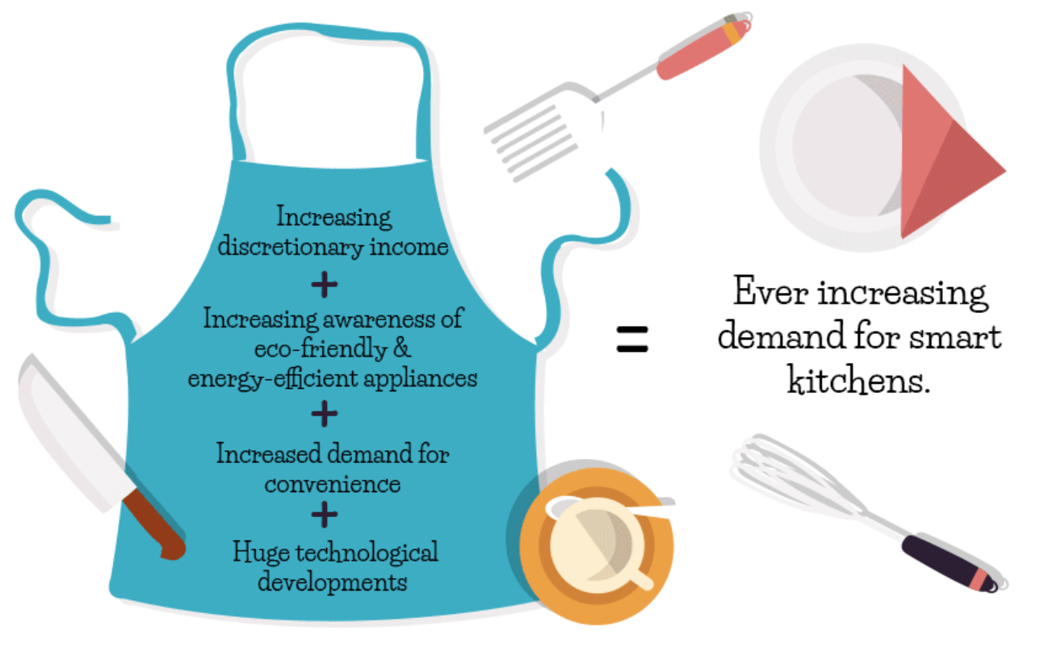
Marketing Goals
Letter | Marketing Goal
a | Low cost
b | User Friendly
c | Durable, Kitchen Safe
d | Food safe
e | Help you learn to cook
f | Easy to clean
Irma Wallace. “The Smart Kitchen of the Future is Here [Infographic].” Infographic Journal, 22 Feb. 2017, https://infographicjournal.com/the-smart-kitchen-of-the-future-is-here/
Notes:
Miguel
Rephrase everything on the chart?
Idk what else to put besides re-reading the stuff we put on the sd1 paper
For the marketing Goals, most of these tie with our engineering specifications. We wanted to make sure that the user learns how to cook.

Slide 6
Engineering Specifications
# | Specification | Target | Marketing Goal
1 | Diagonal Display Size | ≥30 in | a,b,e
2 | Touchscreen Multi-touch Capability | ≥ 2 touch points | b,e
3 | Operating temperature | 60°F ≤ T ≤ 140°F | c,d
4 | Scale Accuracy | ≤ 5g | b
5 | Touch response time | ≤ 100ms | b
6 | Counter Height | ≥ 30 in | b,c,f
7 | Countertop Diagonal | ≥ 35in | a,b,c,f
8 | Total Prototype Cost | ≤ $2000 | a
Notes:
Jason
As you can see in the table, many of our engineering specifications are user focused to provide a great user experience. For example, the UI response time is very important as it will dictate the lagginess and feel of our system. Other important specifications are the scale accuracy and multi-touch capability. The rest of the specifications are there to ensure the system has the proper specs to handle all of the processing.

Slide 7
Design Constraints
Economic and Time Constraints
Overall budget for senior design: $2000
Two semesters to complete project
Environmental, Social, and Political Constraints
Sustainably manufactured components
Proper disposal of electronic waste
Ethical, Health, and Safety Constraints
Smooth, non-porous surface important for safe food handling
non-toxic, durable
appropriate working height
prevent risk of fire or shock, properly insulate and waterproof electronic components
electronics need heat management systems
Notes:
Gera

Slide 8
Relevant Standards
NEMA 250 [5]
Provide a degree of protection of the equipment inside the enclosure against ingress of solid foreign objects (falling dirt).
HTML/CSS W3C
Code efficiency
Device compatibility
User accessibility
Will not follow internet search optimization guidelines since application will function locally
NASA TECHNICAL STANDARD: SOLDERED ELECTRICAL CONNECTIONS [6]
Fillet - smooth concave buildup of material between two surfaces
Soldering environment ventilation system shall comply with OSHA requirements, 29CFR
Javascript Standards [7]
Uniform and consistent coding style
Naming convention/commenting and semicolon use
Notes:
Edwin
Here are the design constraints and relevant standards that were used as guidelines when realizing our project.

Slide 9
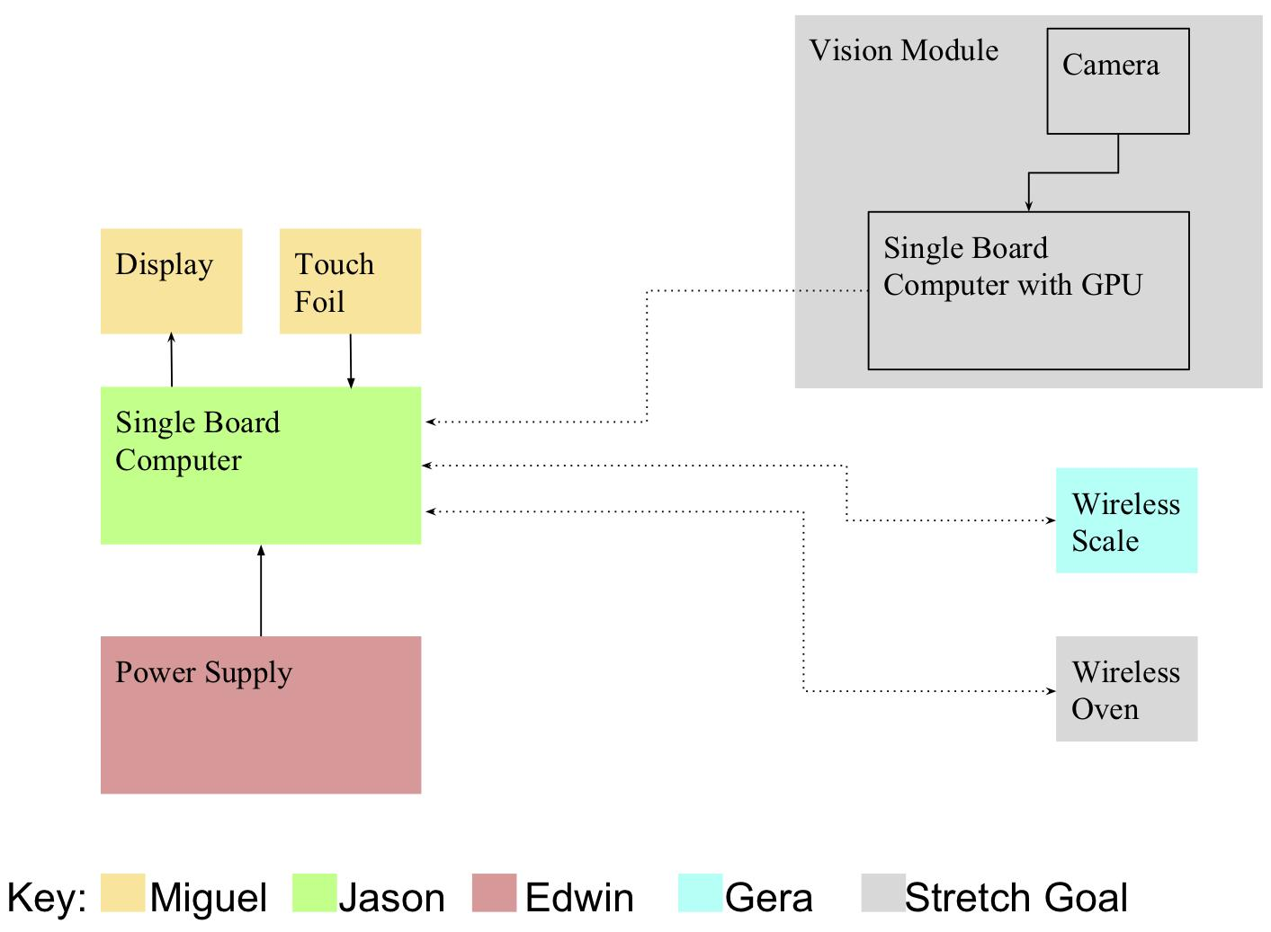
Overall System Block Diagrams: Hardware
Notes:
Gera

Slide 10
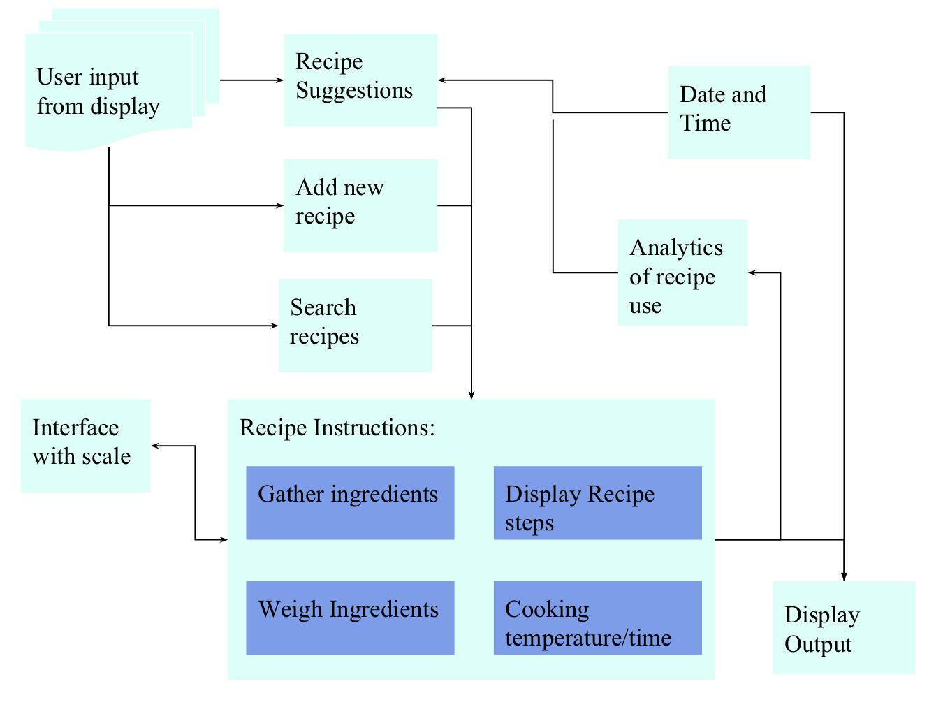
Overall System Block Diagrams: Software
Notes:
Gera

Slide 11
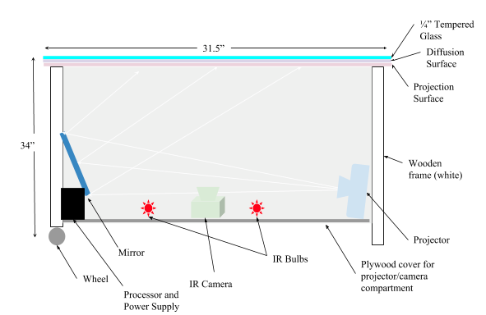
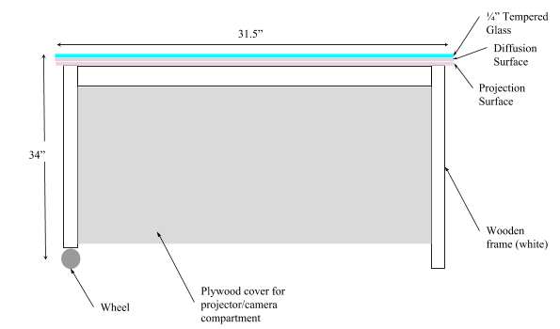
Overall Approach and Proposed Implementation
Notes:
Gera

Slide 12
Significant component and part selections
Single Board Computer
Microcontroller
Wifi Module
Touchfoil
Load Cells
Notes:
Miguel

Slide 13
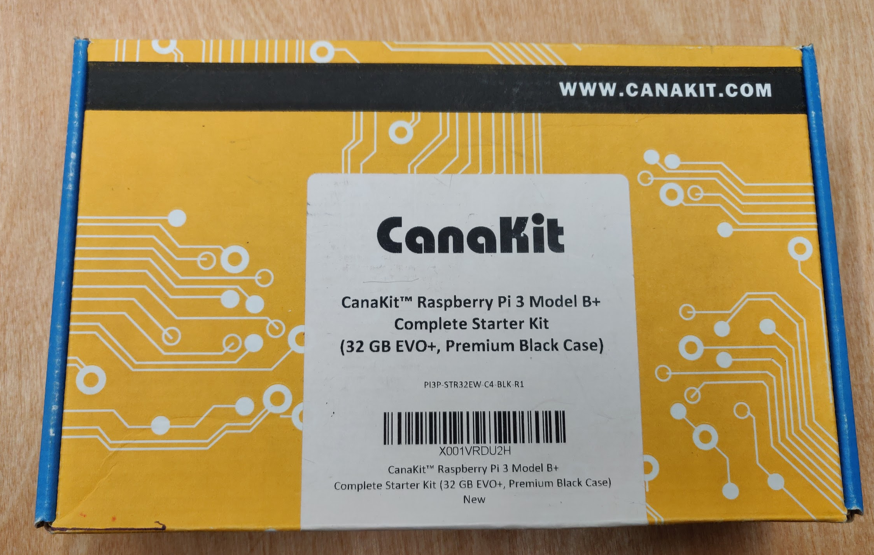
Single Board Computer
Raspberry Pi 3 Model B+
Affordable
Well documented
Past projects have demonstrated what could be done with the Raspberry Pi
Drawback: very limited processing power and RAM
 | Beagle Board | Raspberry Pi 3 b+ | Jetson TX2
CPU | ARM37x 1 GHz | Quad core 1.4Ghz | L2+ Quad ARM
GPU | Power VR SGx530 | Broadcom Videocore IV | Nvidia Pascal, 256 CUDA cores
USB ports | 4 USB 2.0 | 4 USB 2.0 | USB 3.0 + USB 2.0
Power | 2.5A @5V | 2.5A @ 5V | 2.5 @ 5V
Memory | 512 MB | 1GB | 8GB
Storage | Micro SD | Micro SD | 32 GB eMMC
Software | Linux | Raspbian | Jetpack (linux)
Price | $150 | $35 | $468.00
Notes:
Miguel
The single board computers that we researched can be seen on the table as shown. The reason that we chose the raspberry pi, was to keep costs low, as well as the available documentation for the pi. Through our research we saw what past projects here at ucf and other schools were able to do with the pi.

Slide 14
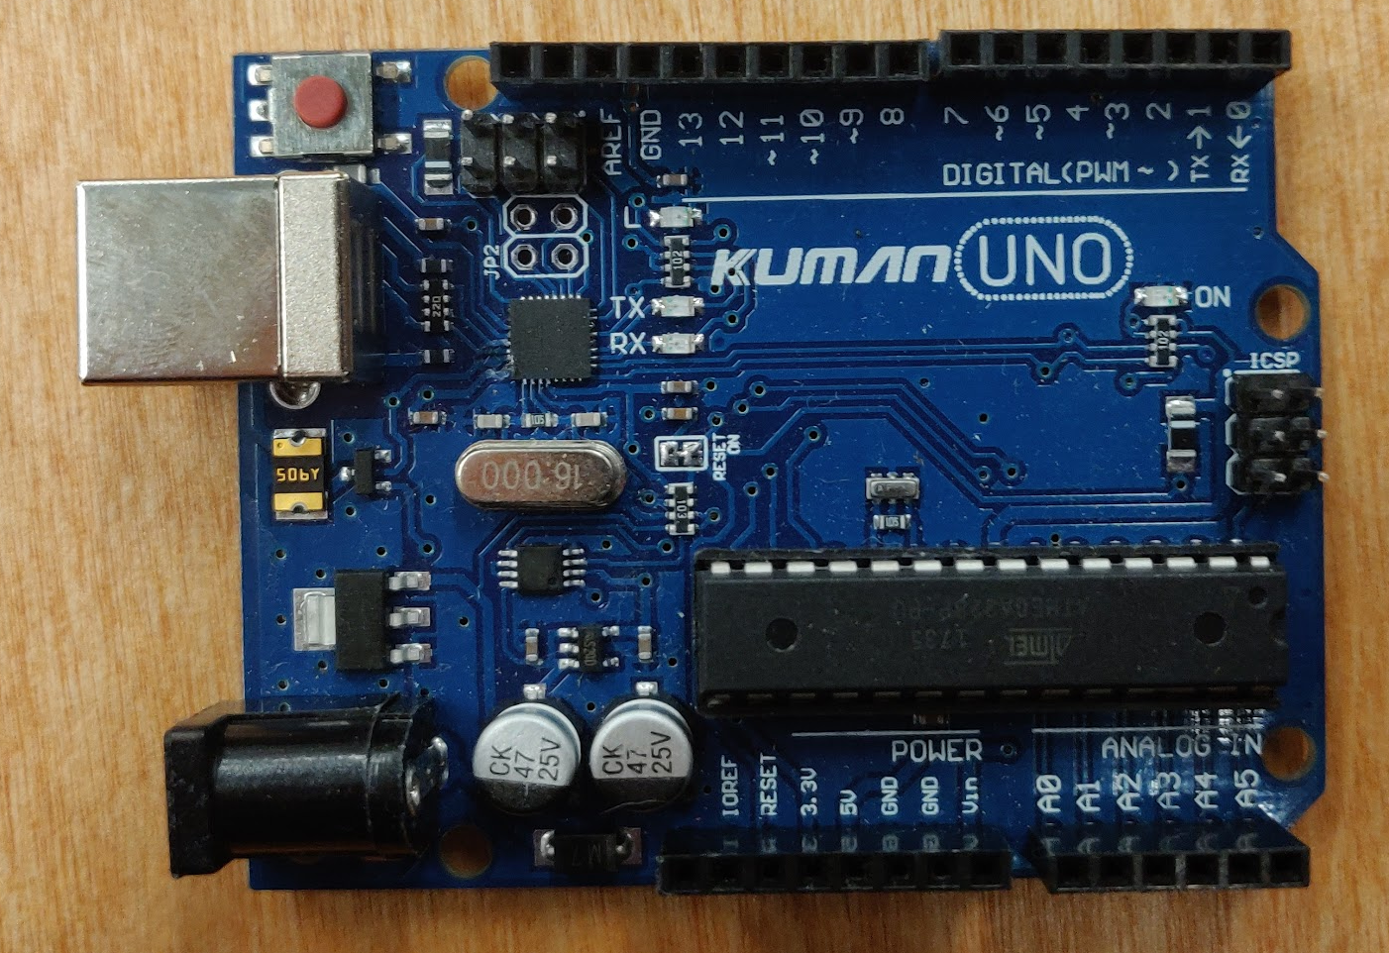
Microcontroller
ATMEGA328P (Arduino Uno)
Easy to use
Cheap
Small footprint
Well documented with lots of open source libraries and examples
Compatible with our chosen A/D Converter and wifi module
 | CC3200 | ATMega 328P
Cost | $0 (Provided by TI Lab) | $1.96
Clock speed | 1MHz-80MHz | 16Mhz
GPIO pins | 27 | 23
Operating voltage | 2.1V - 3.6V | 5V
Communication | Wifi | With external module
Temperature sensor | Yes | With external module
Documentation | Detailed | Available
Libraries | Requires TI IDE | Open source
Power Consumption | Low | Medium
Size | Small | Small
Notes:
Miguel
For the Microcontroller we decided to go with the ATMega 328P. The reasons being, is the multiple GPIO pins, cheap,
“The ATMEGA328p- AU was chosen as our microprocessor for the wireless scale because it was relatively inexpensive, well documented, and easy to prototype. ”

Slide 15
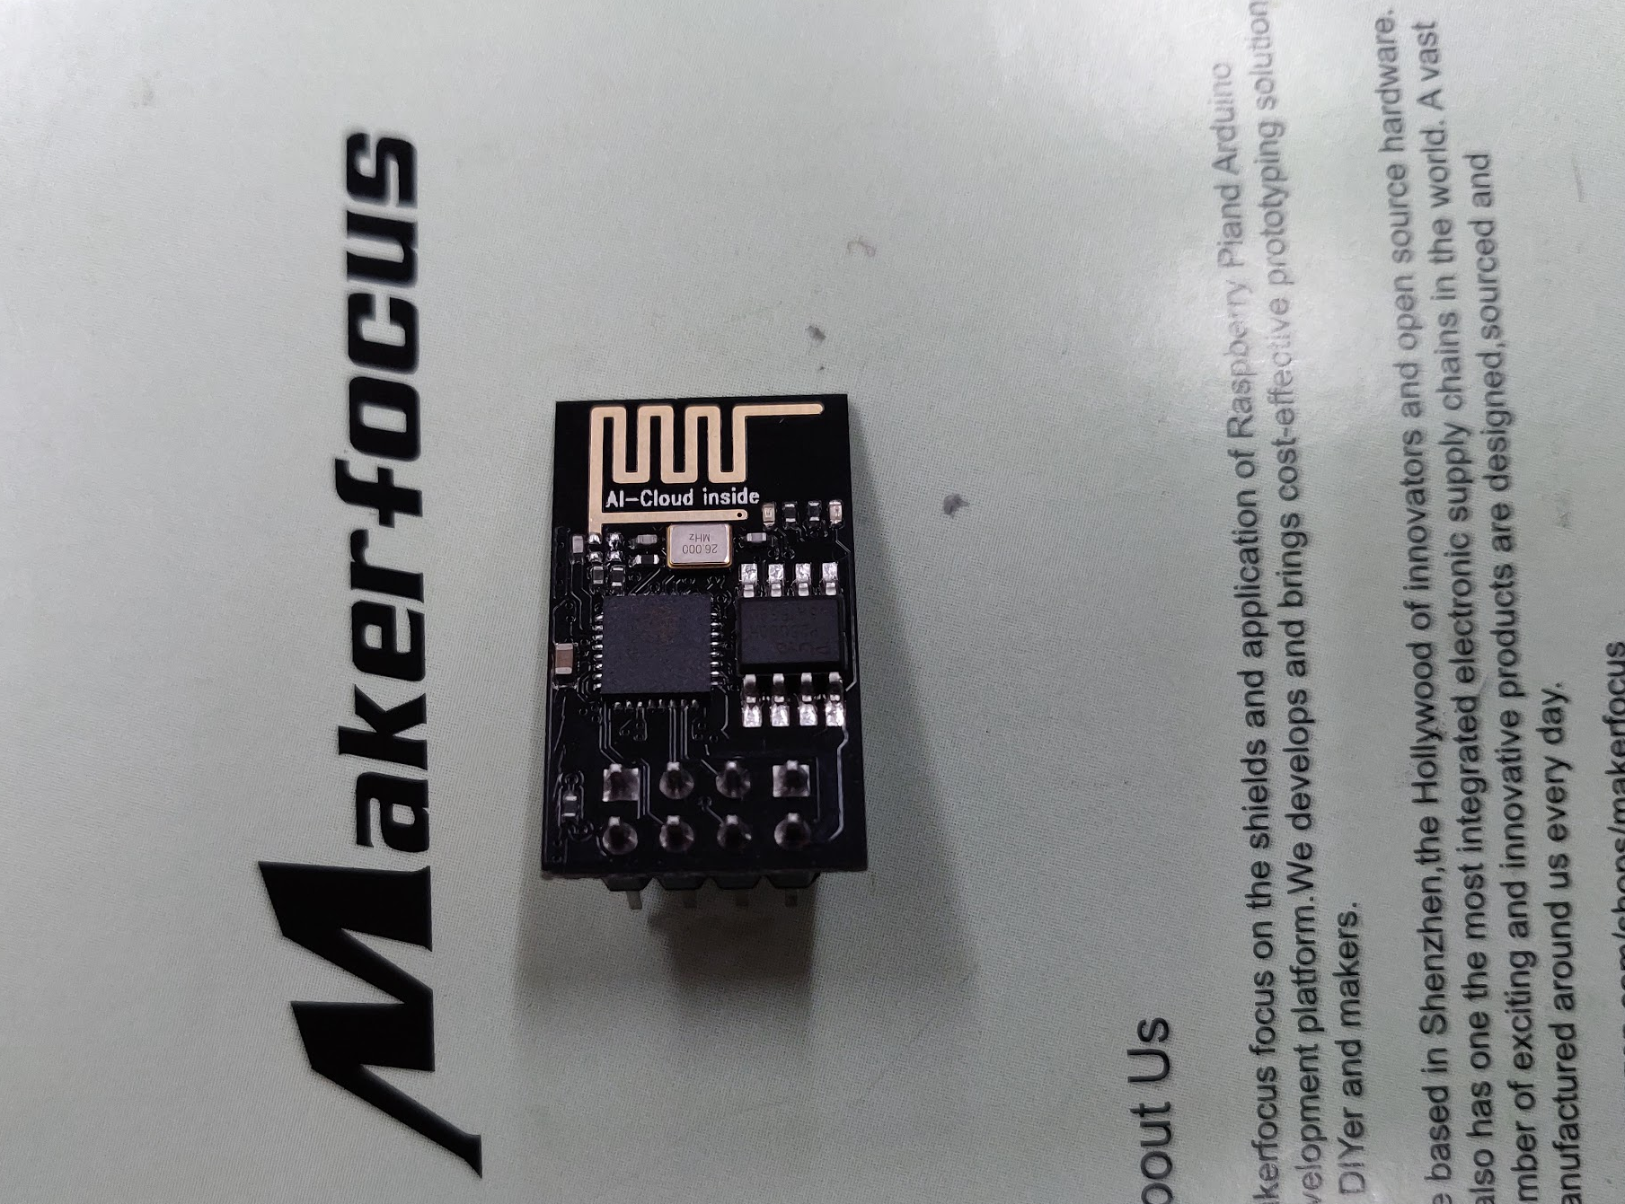
Wifi Module
Cost | $1-$3
Clock speed | 80Mhz
Operating voltage | 3.3V
Wifi | IEE 802.11 b/g/n Wi-fi
Documentation | Available
Libraries | Open source
Power Consumption | 0.5uA-170mA
Size | 14.3 X 24.8mm
ESP8266 ESP-01
Used for breadboard testing
Small size, small price.
Cheap external module with a relatively small footprint
Easy to integrate with ATMEGA chip
Notes:
Miguel
Since the Atmega didn’t come with built in wifi. We looked for a wifi module. The Esp-01 model satisfied all our needs. It was really inexpensive because we bought them in bulk, it has a small footprint, and it was easy to integrate with the ATMega.

Slide 16
Touch Screen: Xiamen Touch Foil
Important factors:
Cost
Response time
Number of touch points
Driver software
Capacitive touch foils varied very widely in cost.
Most US vendors cost upwards of $2000
alibaba.com was used to purchase directly from the manufacturer at a lower price
Vendor/Product name | Xiamen Touch [16] | Green Touch [15] | Gerteise [44] | Pro Display [45]
Touch Points | 10 | 10 | 10 | N/A
Response time | 10ms | <10ms | <2.5ms | 18-50ms
Driver Software | Linux, Mac | Linux, Mac | Windows, Linux | Windows, Linux
Light transmittance | >93% | >90% | N/A | >93%
Aspect Ratio | 16:9 | 16:9 | 16:9 | 16:9
Diagonal Size | 32-47” | 5”-60” | 27-55” | 17”-100”
Time for shipping | 7 days | N/A | 1- 2 months | N/A
Cost | $115 | $105 | $174.50 | $1,241
Notes:
Gera

Slide 17
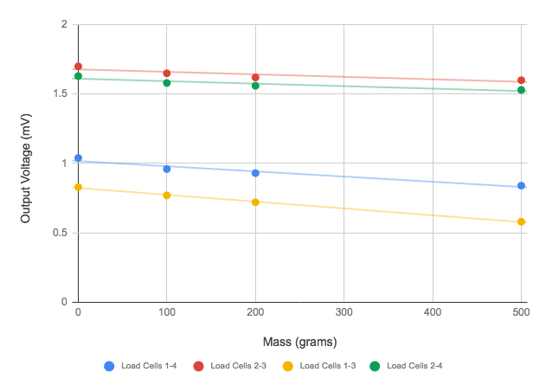
Load Cells
Vendor/ Manufacturer | Omega [48] | Manyyear [49] | Kitchen Scale (already owned)
Load Range | 0-25lb | 0-5kg | 0-5kg
Output Voltage | 1mV/V | unknown | unknown
Excitation Voltage | 5 V (DC) | 5 V (DC) | unknown
Bridge Resistance | ≥350Ω | 1000Ω | ~500Ω
Thermal Sensitivity | Low | 2% | unknown
Type | Compression | Compression | Compression
Documentation | Available | Available | Not available
Bridge type | Full | Full | Half
Accuracy | 0.5% | 0.05% | unknown
Size | ¾” | 37x47 mm | ¾”
Cost | $350.00 | $150 | $0
We choose to use load cells scavenged from previously owned kitchen scales due to budgetary constraints. All device specifications needed to be measured.
Load Cell Pair Output Voltage vs Applied Mass
Notes:
Gera

Slide 18
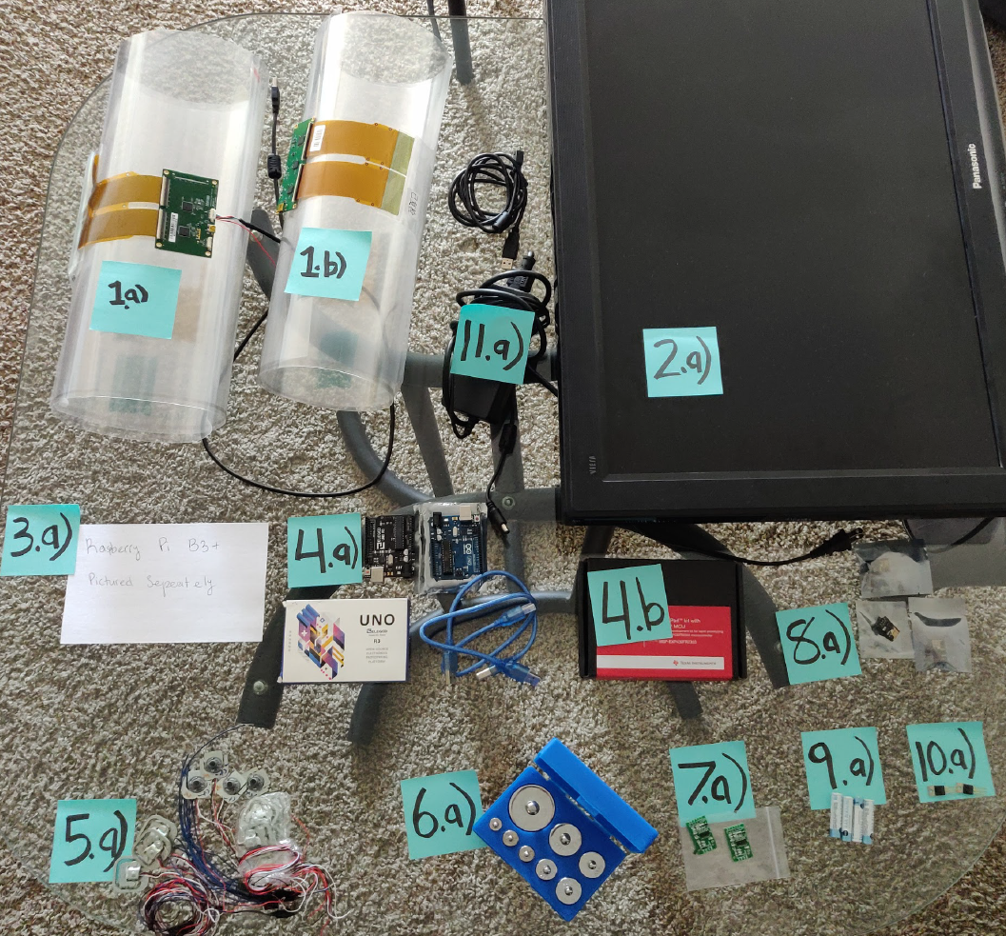
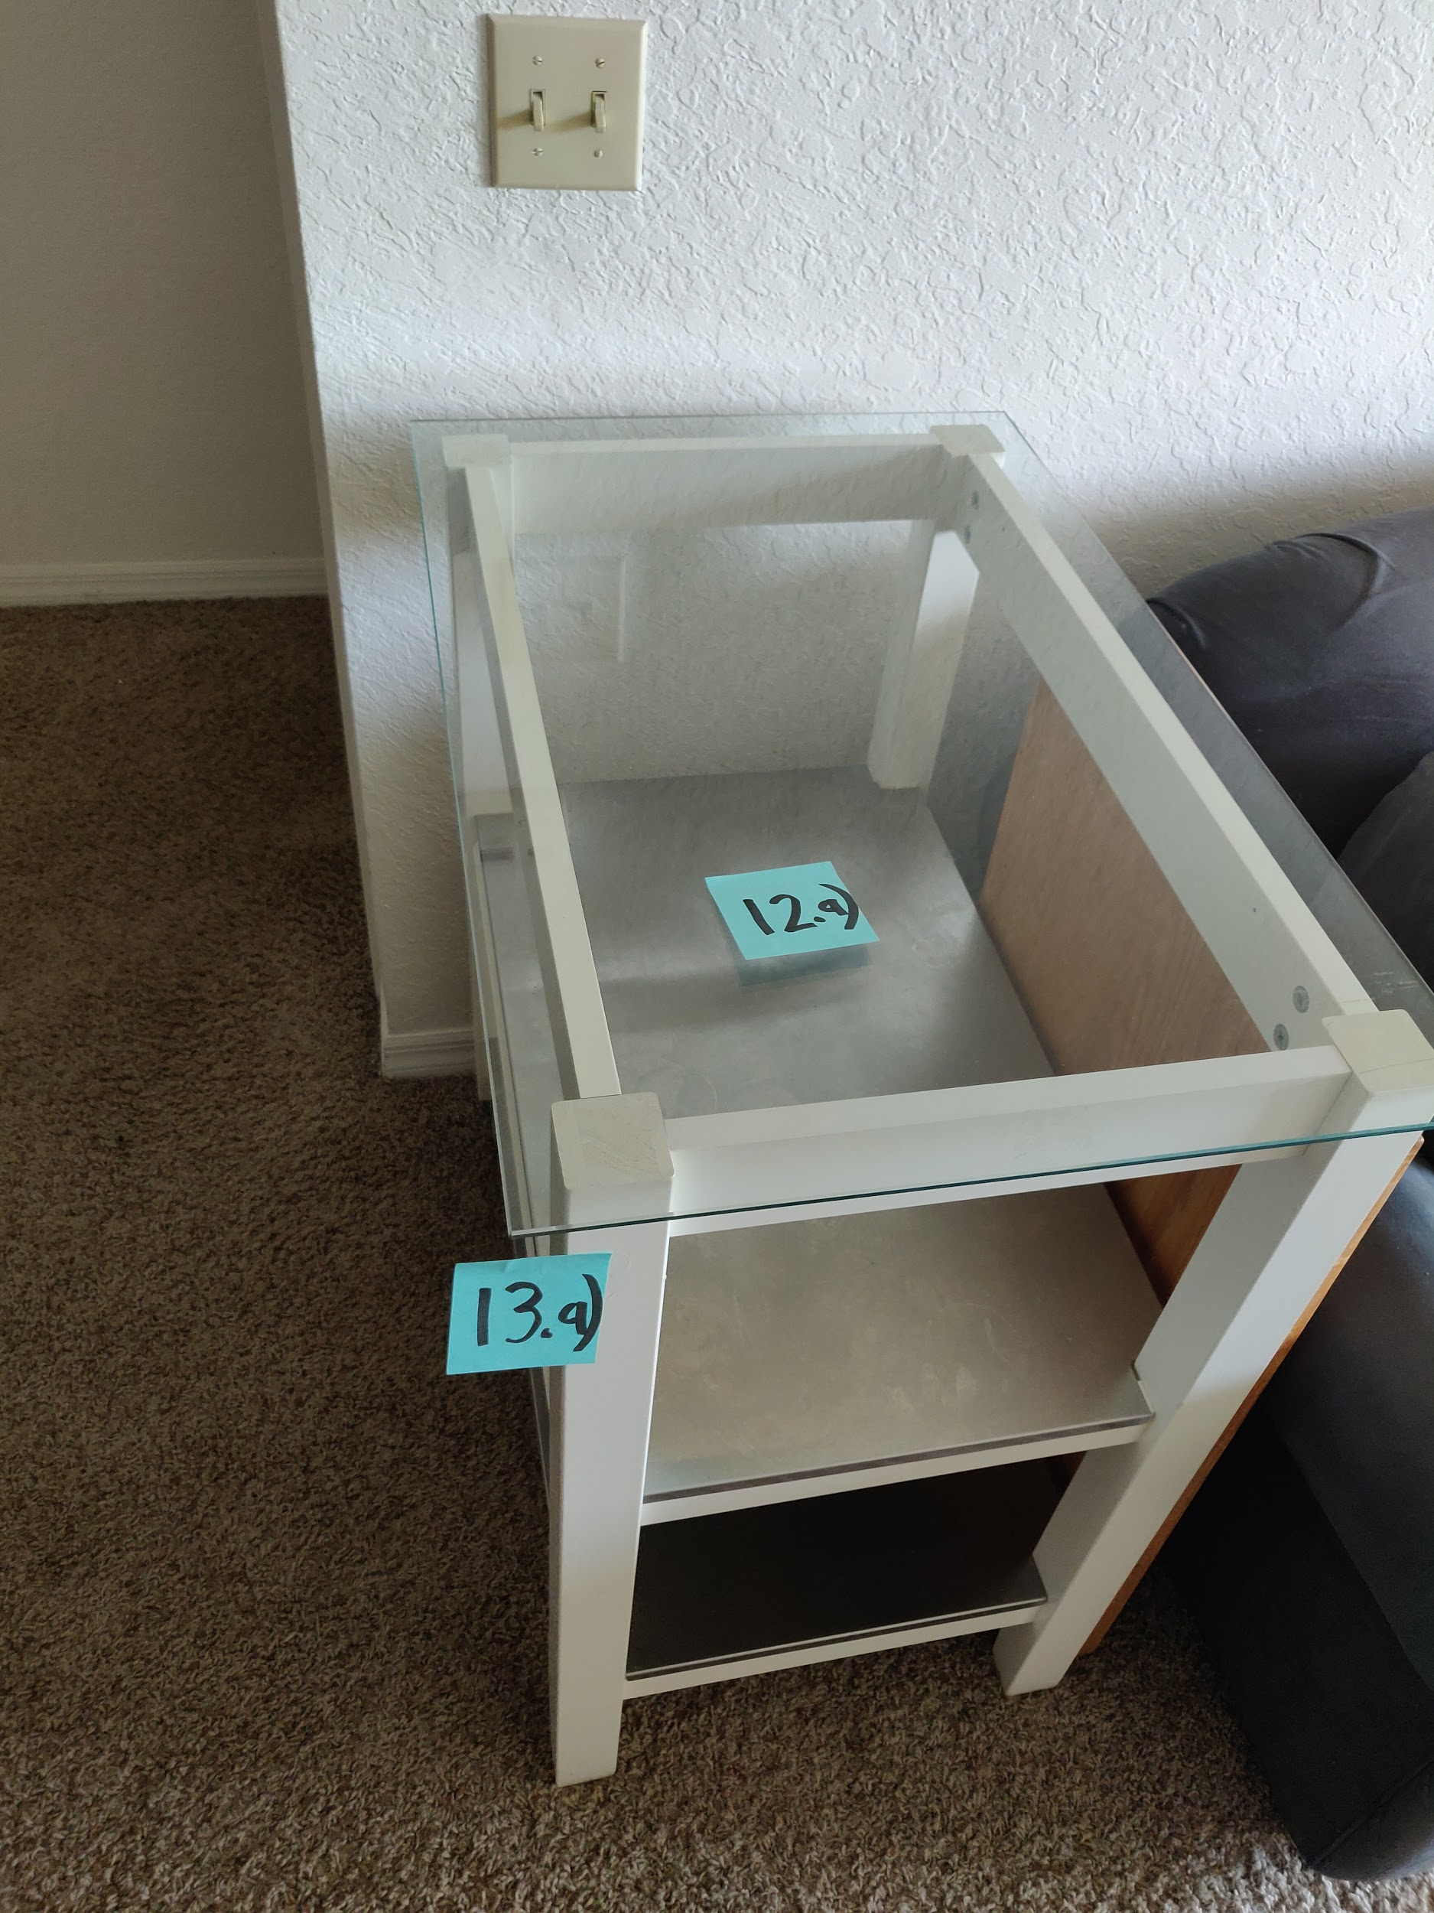
Part Selection Summary
Notes:
Miguel
Here we demonstrate all the parts that, put together, form what will be our first prototype. We have the touch foil, the TV, the raspberry PI, the glass and the kitchen cart, which will form our smart tabletop. We also have the microcontroller, load cells, A/D converter, wifi module and some of the components which will form the wireless scale and PCB.

Slide 19
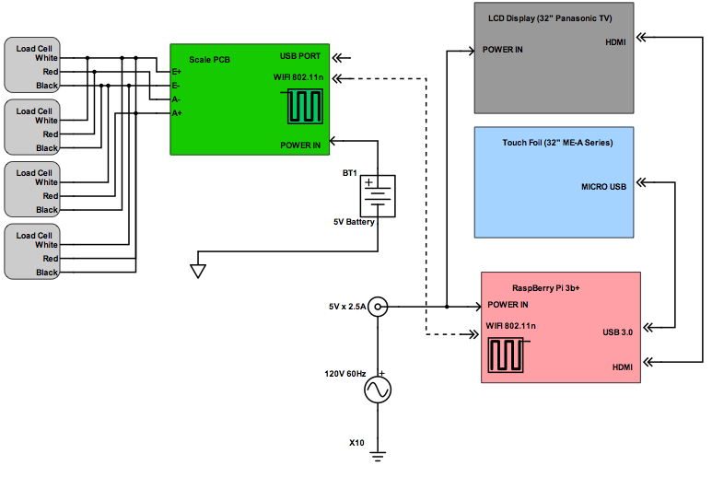
Hardware Design
Two subsystems: display/ touch-foil/ single board computer and the wireless scale.
The first subsystem: LCD display, touch-foil, and single-board computer.
This subsystem will be powered from AC mains via a wall wart.
Touch foil will be powered by and transmit data via a USB connection to the raspberry pi.
Wireless Scale: custom designed and printed PCB connected to four load cells and powered by a 6V battery.
Scale PCB: A/D converter, MCU, and wifi module as well as voltage regulation
Notes:
Gera
5v to 9v

Slide 20
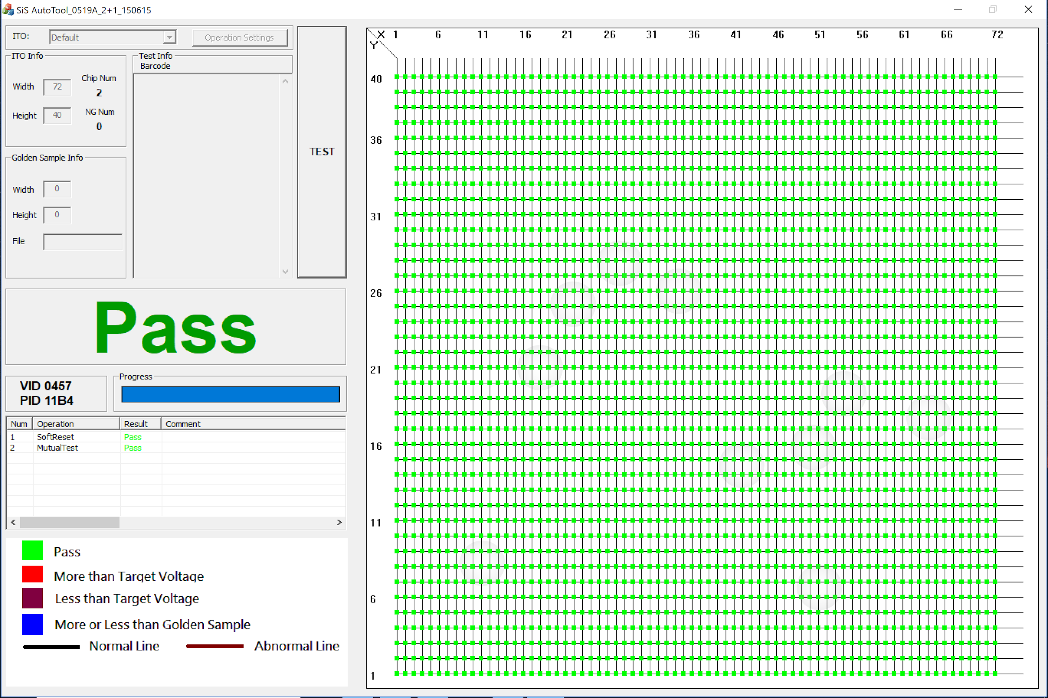
Subsystem 1: Single Board Computer and Touchscreen
Successes:
Multi-touch capability
Compact design with storage space
Challenges:
Challenges with touch foil
Noise from TV
Difficult to paste without air bubbles
Ribbon needed to be carefully secured
TV size and heat dissipation
Limited processing power
Technology | Capacitive Touch foil [15],[16] | IR Touch Technology (RDI, FTIR)
Response time | Fast | Medium
Multitouch | Touch points add to cost | Depends on software
Light transmittance | High | 100%
Sensitivity to objects | Low | High
Sensitivity to noise | Moderate (magnetic, electrical) | Moderate (natural light)
Installation size | Small | Large
Suitability for kitchen application | High | Unsuitable (exposed LEDs and electronics)
Software | Provided by manufacturer | Open source (OpenCV,CCV2)
Cost | Large range ($100-$2000) | Moderate (~$100)
Notes:
Edwin:
In our first subsystem, we have the raspberry pi and the touch foil integrated with each other. In order to test the touch foil’s capabilities, we rested it underneath the tempered glass and connected its circuit board through USB to a laptop. The foil came with testing software which would let us now that the foil is operational as seen in the image on the screen where it passes. Then we realized that we could control the laptop through touching the foil. This is when we connected it to the raspberry pi, where it demonstrated the same behavior.
Through this we succeeded in demonstrating successful multi-touch capabilities and help compact our design and allow for storage.
Challenges that resulted in this subsystem were the touch foil, which was noisy due to its distance with respect with the TV, pasting the foil to the glass without having air bubbles and the ribbon of the circuit board had to be still and secured at all times or else the foil would create false touch points.
Other challenges included the TV dissipating heat under the wood cover, the size of the TV which proved bigger than the cart dimensions and limited processing power from the PI.

Slide 21
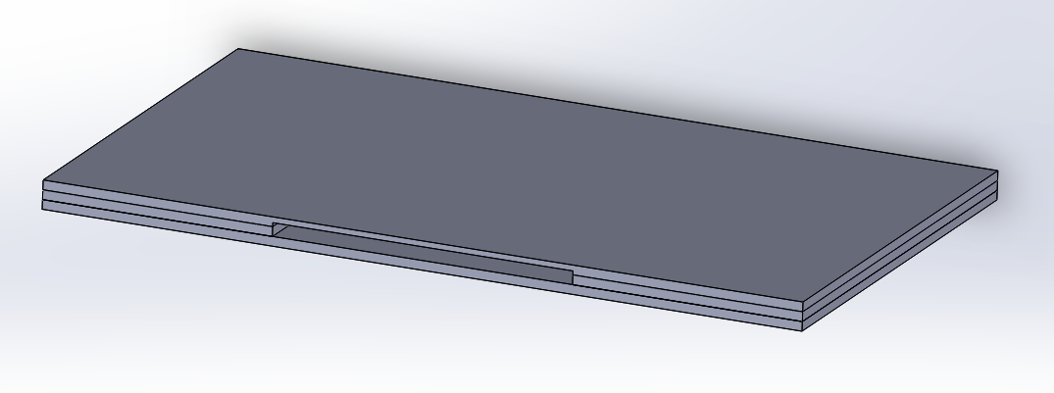
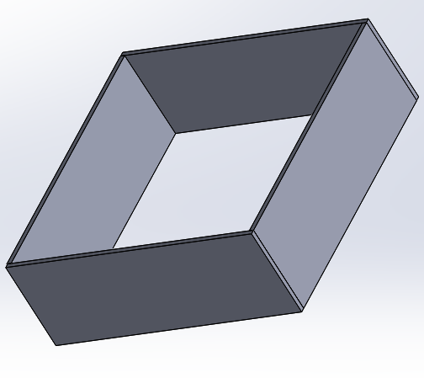
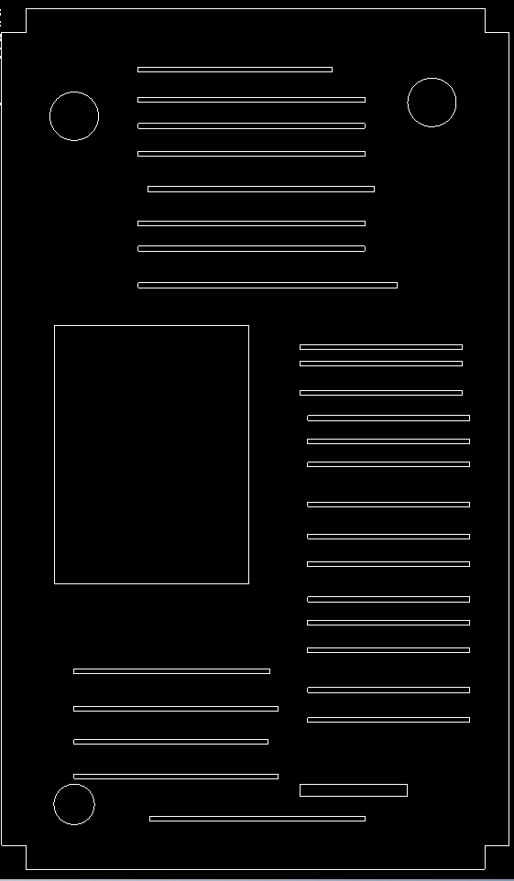
Subsystem 1: Solidworks
TV wood frame
Cutting Board
Secures foil circuit within slit
Added feature
Bottom Cover
Allows for ventilation and access to Raspberry Pi
Notes:
Edwin
Most of these issues were addressed by adjusting the distance between the TV and the foil to the point where minimum disturbance was observed and the foil’s circuit was secured inside the cutting board. Although we still have air bubbles in our screen, it causes no disturbance to the experience
In order to prevent the TV from overheating from its own heat dissipation, we created a bottom cover with slits for it to ventilate.The Pi was still used since other single board computers were more expensive.

Slide 22
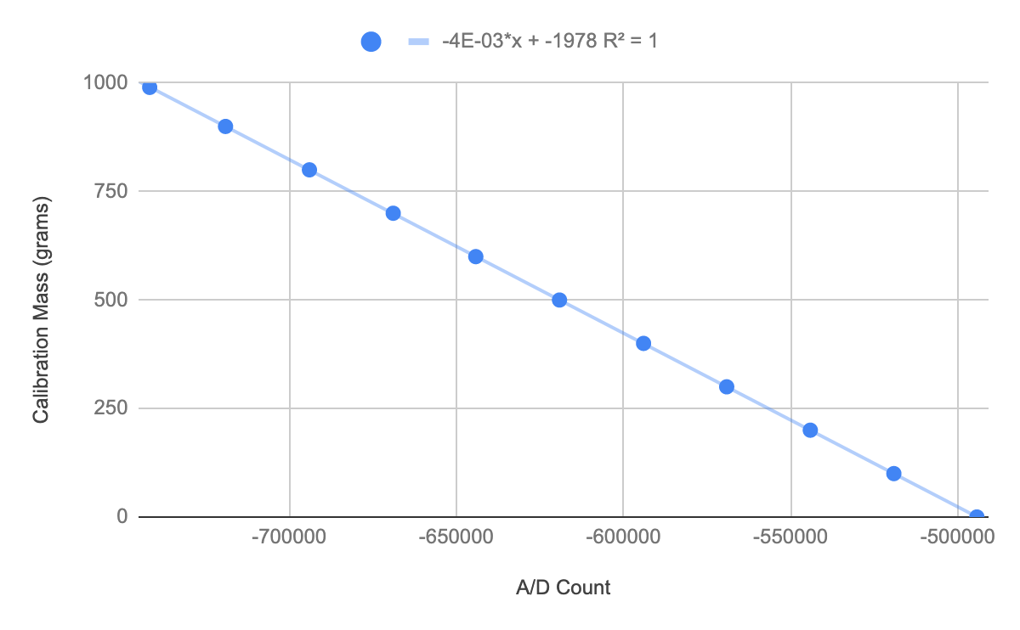
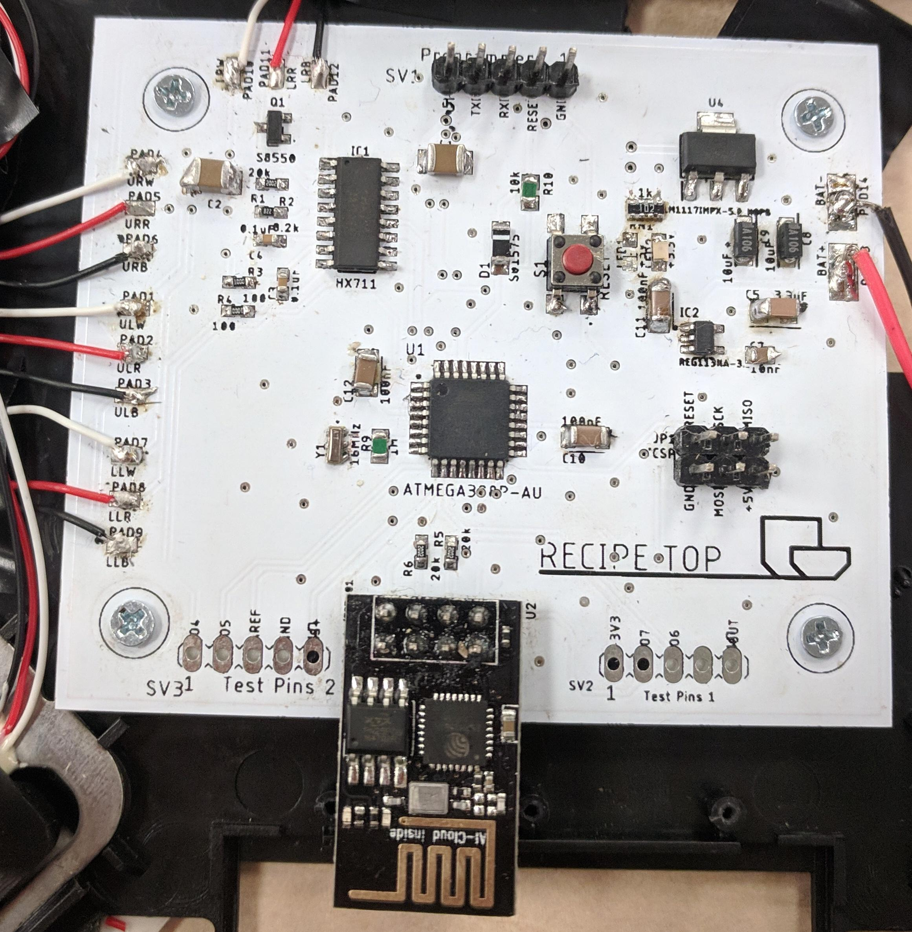
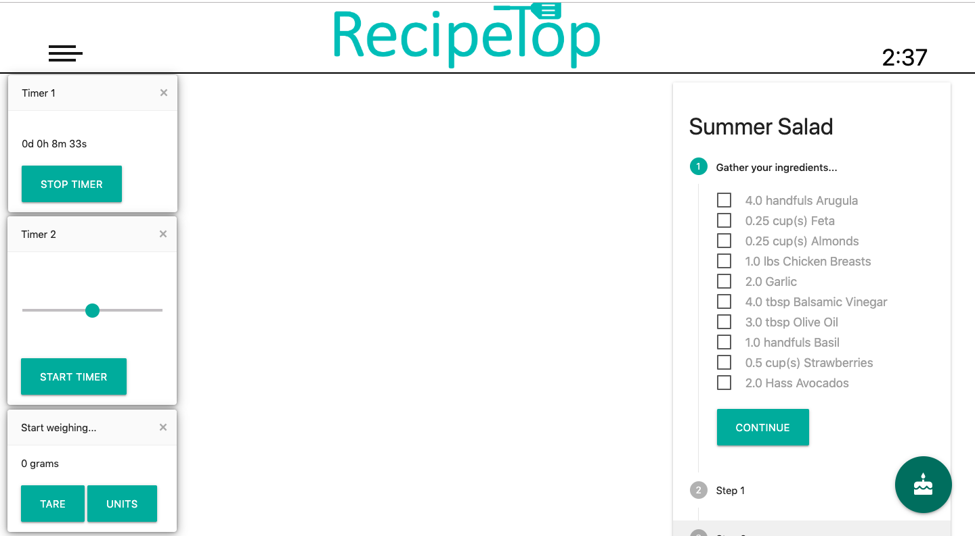
Subsystem 2: Wireless Scale
Successes:
Accuracy of scale
Integration with Subsystem 1
Challenges:
Case that evenly distributed weight over all four load cells
Calibration
Communication between ATMEGA and wifi module
Notes:
Gera

Slide 23
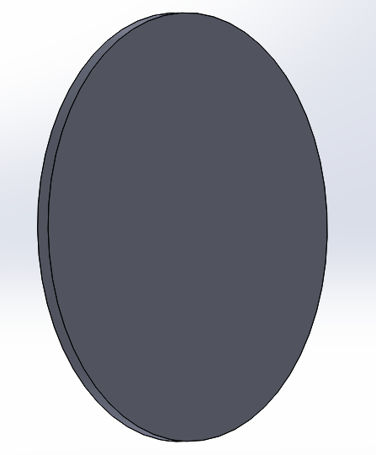
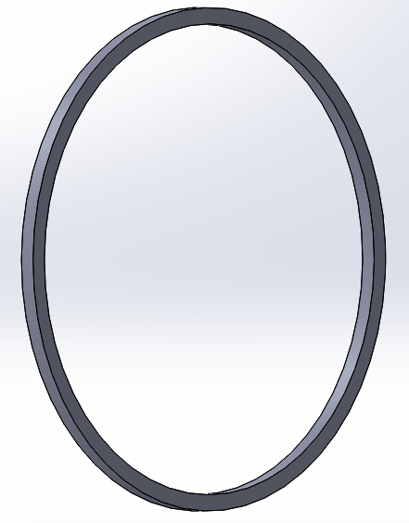
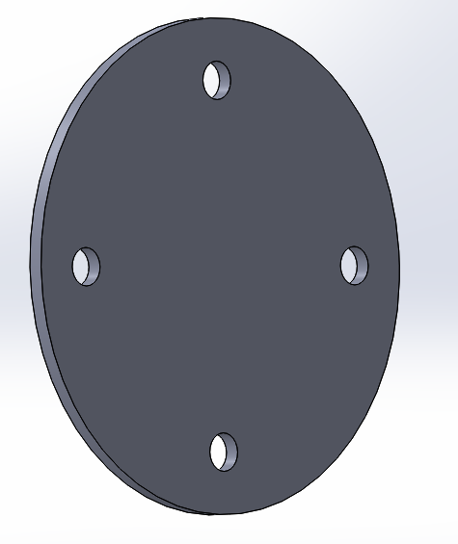
Subsystem 2: Wireless Scale Solidworks
All designs consist of a outer diameter of 7-¾”
Wood Panels used were ¼”
Scale Enclosure
Top Section (a)
Middle Section (b)
Bottom Section (c)
(a)
(b)
(c)
Notes:
Edwin
Here is the Solidworks of the scale case. Image (a) is the top section of the scale. Image (b) is the middle section and fourof these were used to build the middle segment. And Image © is the bottom section where you see the cutouts for the load cells.

Slide 24
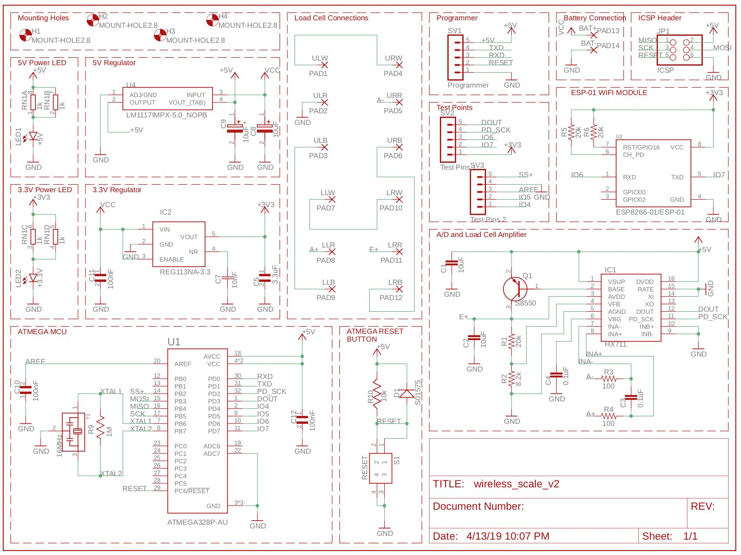
Schematic
Notes:
Edwin
Here is our schematic for the wireless scale, which will send real time data and interface with our assistant cooktop. It is categorized in 4 parts, microcontroller, power, Analog to digital converter, and the Wifi Module.

Slide 25
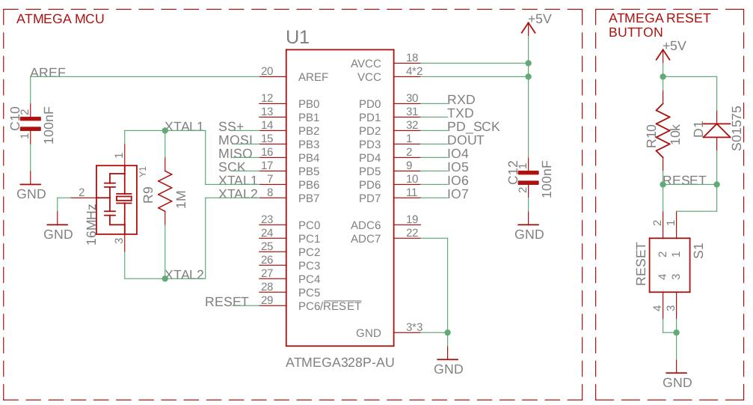
Microprocessor
ICSP to program microprocessor
16 MHz clock
Reset Button is active low
Decoupling capacitors on power pins
Notes:
Edwin
The Microprocessor we used is the ATMEGA328P-AU, for its smaller footprint compared to its through hole counterpart. We have it connected to ICSP header pins in order to burn the bootloader onto our MCU. We have a 16MHz resonator, which will be placed close to the microprocessor to avoid any disturbance in the clock signal.

Slide 26
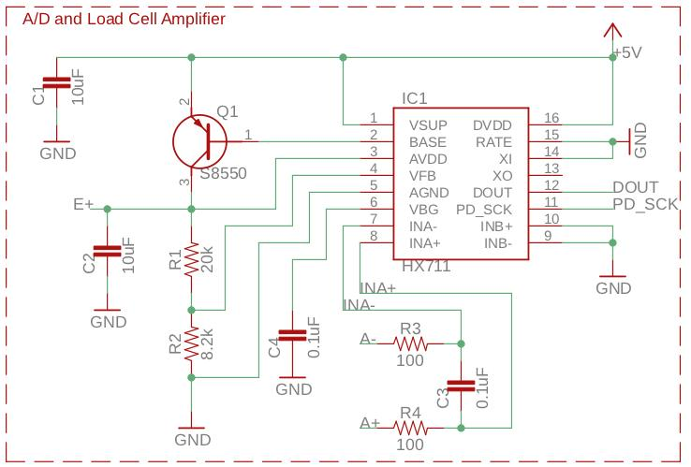
AD Converter
Measures voltage from load cells and sends it to microcontroller to measure weight
HX711 provides serial interface for data retrieval via two control pins:
Clock line
Data line
Notes:
Gera

Slide 27
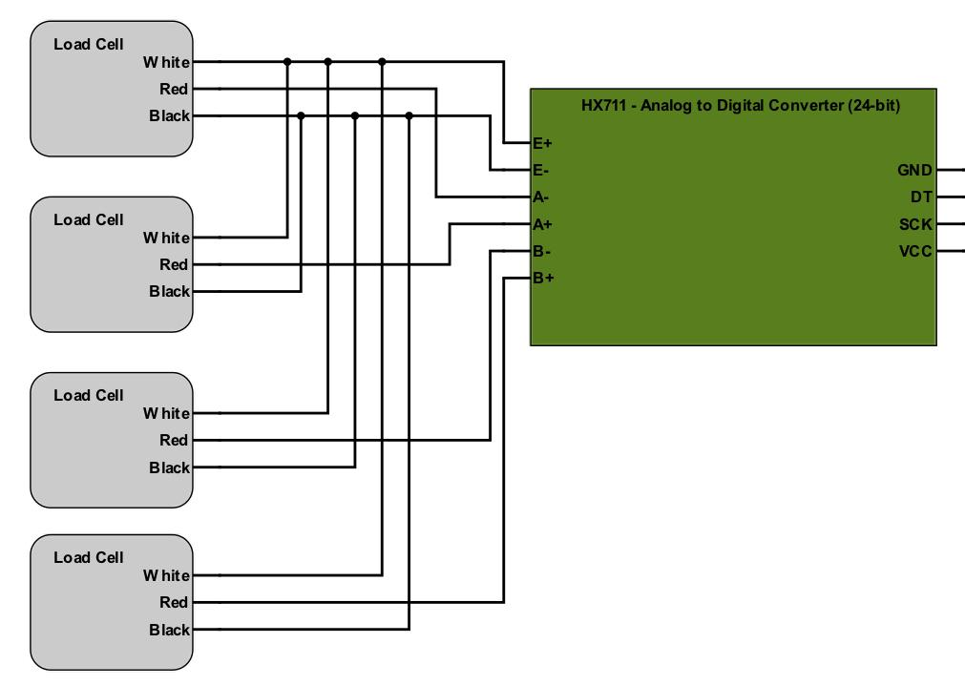
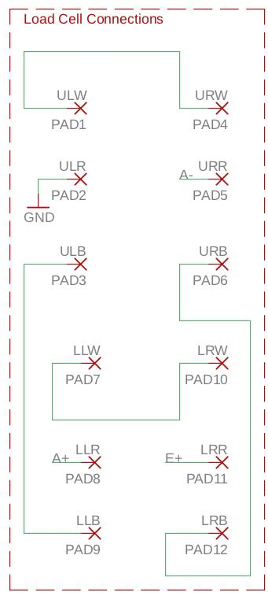
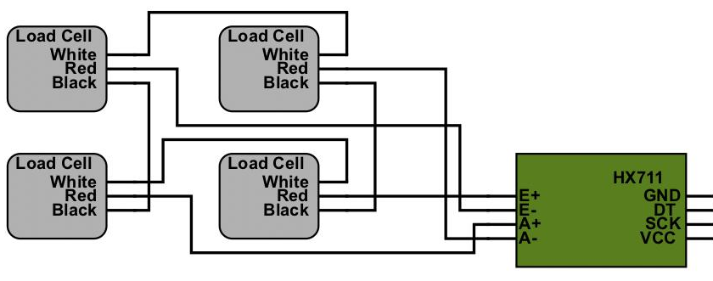
Load Cell Configuration
4 half bridge load cells will solder to wire pads on board for more reliable connection
Connected in series
Notes:
Gera

Slide 28
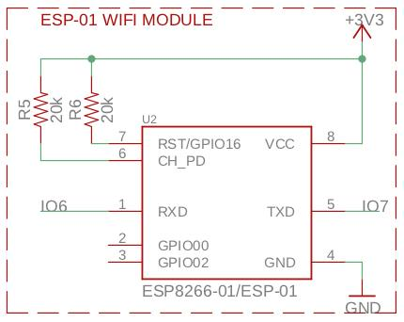
Wireless Connection
ESP8266 ESP-01 Wifi Module
Powered by 3.3V
Pull up resistors for Reset and Chip Enable pins
Connects to ATMEGA through UART at a baud rate of 9600 on pins 6 and 7
Communicates with ATMEGA using SoftwareSerial open source library
Notes:
Miguel: Here is the schematic for the wifi module.
To ensure it was in the correct operating state we had to use two pull up resistors for Reset and Chip Enable pins so that it would be powered by 3.3v. Adds latency due to serial communication. Sotware doesn’t support high baud rate.so a future improvement would be to stray away from using a seperate module.

Slide 29
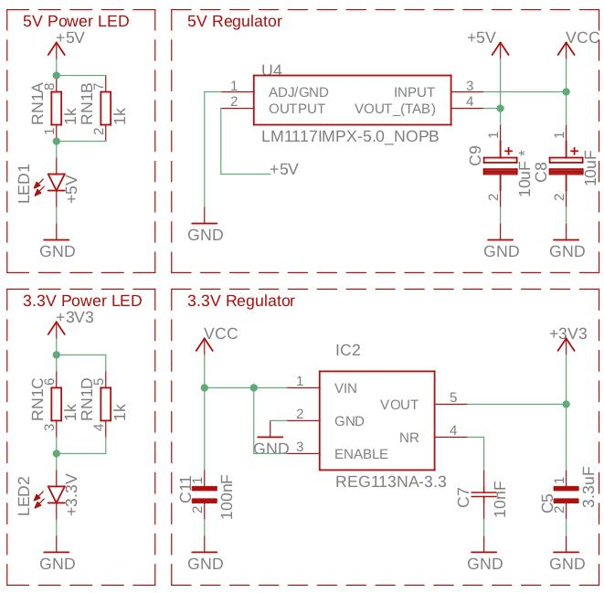
Power
Power to be received from 4 AAA batteries attached to a switched case
5V regulator to power microcontroller and HX711 (ADC)
3.3V regulator to power Wifi Module
Decoupling Capacitors are placed in the design to smooth out noise prevent interference
Notes:
Edwin
In this power segment of our schematic, power will be received by 4 AAA batteries. The 5V regulator will feed power to the microcontroller and the HX711 since they both operate at 5V.Then we have 5V being fed to the 3.3V regulator, which will be used to power the Wifi Module. We picked 4 AAA batteries due to the less space it takes up. This makes for a smaller the PCB enclosure, which is important to us in order to make the design look slim and neat and not bulky.

Slide 30
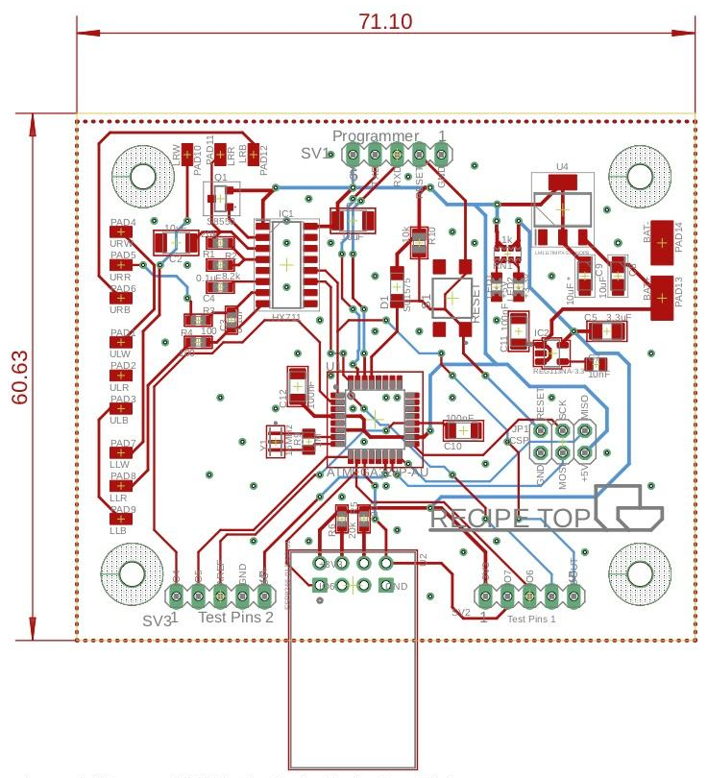
PCB
Created in Eagle
60.63mm x 71.10mm
Microcontroller is centered in board design
Surface mount wire pads for four 3-wire load cells
ICSP, programmer and testing points for quick troubleshooting and code upload
Multiple vias to have an even ground plane everywhere and for heat dissipation purposes
Notes:
Edwin
This is the final version of our PCB. Its about 61x71mm and its designed with the microcontroller centered on the board, has the wifi module on the bottom, the ADC (HX711) on the top left and it has 12 wire pads in order to solder 4 load cells that have 3 wires each. We placed mounting holes in order to secure board to PCB enclosure within the scale. We have the ICSP, programmer and testing points for quick troubleshooting and code upload and finally we have multiple vias place around our PCB in order to evenly distribute a ground plane through both layers and also for heat dissipation.

Slide 31
Hardware Challenges
Soldering efficiency
Component assembly
Inventory
Organization
Gera’s laptop....
Datasheets - component orientation
Notes:
Edwin
Soldering Efficiency was obtained through soldering multiple boards. Also we learned it was more efficient to test as we soldered through individual functional sections before continuing.
We tried placing our load cells in a parallel configuration, but results weren’t as good as we hoped. Upon further research and testing, we figured out that a series configuration provided the best results
Having enough components was an issue and figuring out which component goes where. Since we solder many boards, inventory had to be run often. As for figuring out what component goes where, our project manager, Gera did a great job in labeling all the component bags with their respective designators.

Slide 32
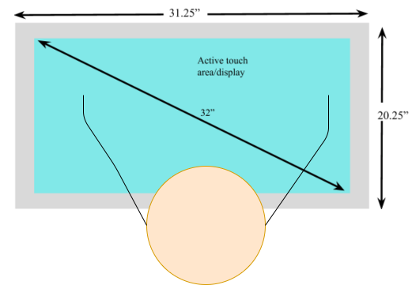
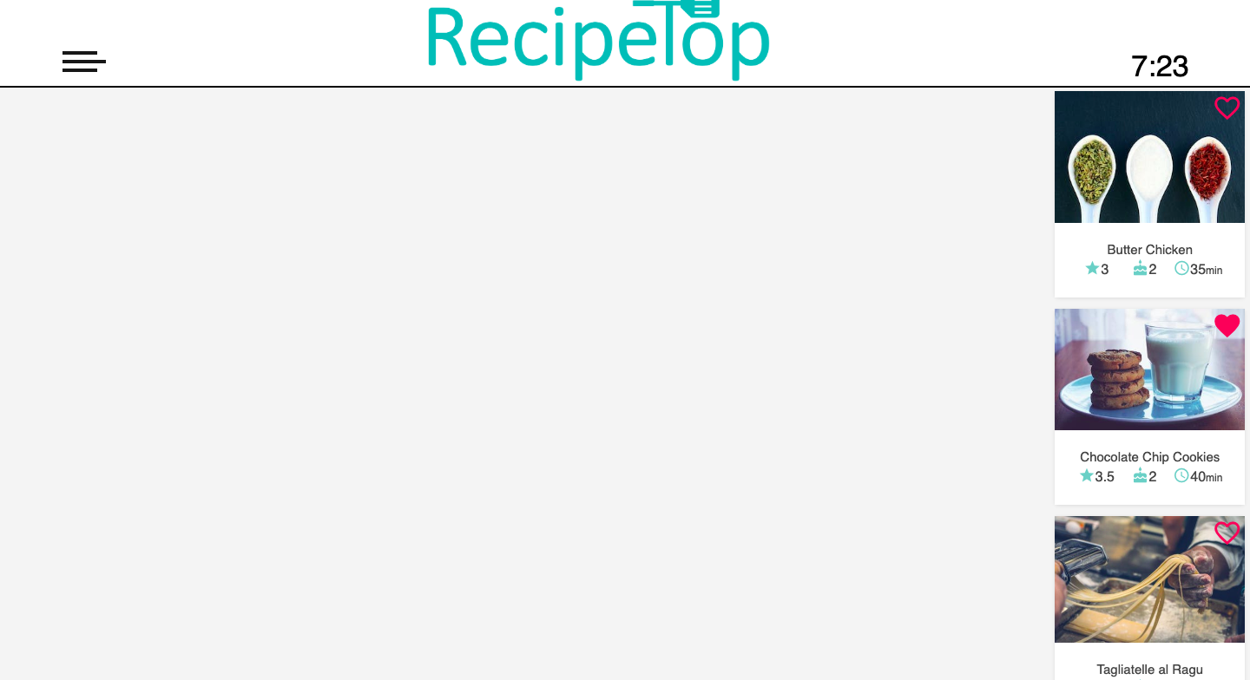
Software Design: Approach
Front-end: HTML5, CSS3, Javascript, Materialize
Back-end: Django
Design UI for a counter-top
Similar to tablets/phones but on a bigger scale
Hardware independence
.
Notes:
Jason
Due to the fact that our application is very data driven, we decided that the best approach would be to create a website. The design of our website will provide a database for storage and retrieval, an API for all functionality, and an easy to design front-end for the user to interact with.
Miguel
For the front-end we used HTML, js, css, and a css library called materialize. The design approach for the for the ui layout and components is similar to that of a tablets/phones but on a much larger scale. We had 32 inches to play with, as well as partitioning

Slide 33
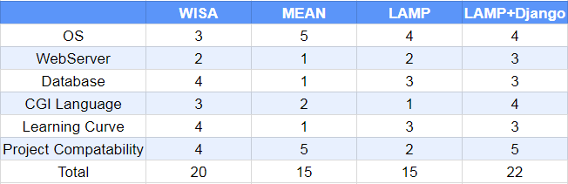
Software Design: Stack Choice
Notes:
Jason
The first design choice that needs to be made when creating a website is the software stack. As you can see in our decision matrix, the LAMP stack along with the Django framework ended up being our best option. LAMP stands for Linux, Apache, MySQL, and in this case Python. We decided to add the Django framework as it greatly reduces the development time of our website.

Slide 34
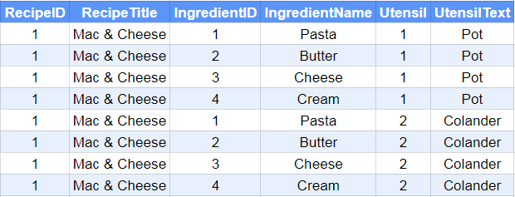
Database Memory Optimizations: Naive Approach
Naive approach is multiplicative in memory O(#recipes*#ingredients*...)
Notes:
Jason
Another major design choice is our optimizations. Since our target environment is a single board computer, we decided to optimize for memory when creating our database. As you can see in the example tables, a recipe with a list of ingredients and utensils can be represented in two ways. The naive approach duplicates a lot of data and the number of rows is multiplicative. In order to optimize for memory, we create lookup tables to be allow us to implement lists in very little memory. Finally, since all of the ingredients across all recipes are stored in a single table, we never have to create more than one row of any ingredient.

Slide 35
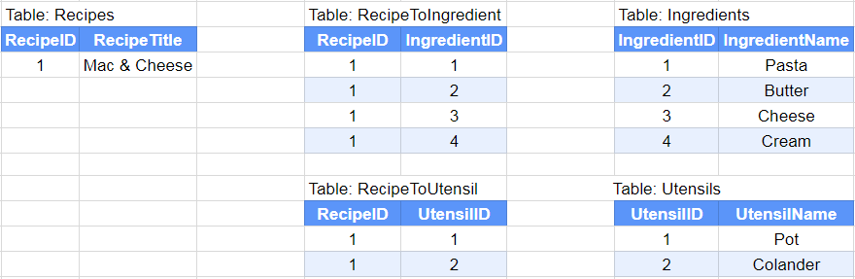
Memory Optimized Approach
Optimized approach is linear in memory: O(#recipes+#ingredients+...)

Slide 36
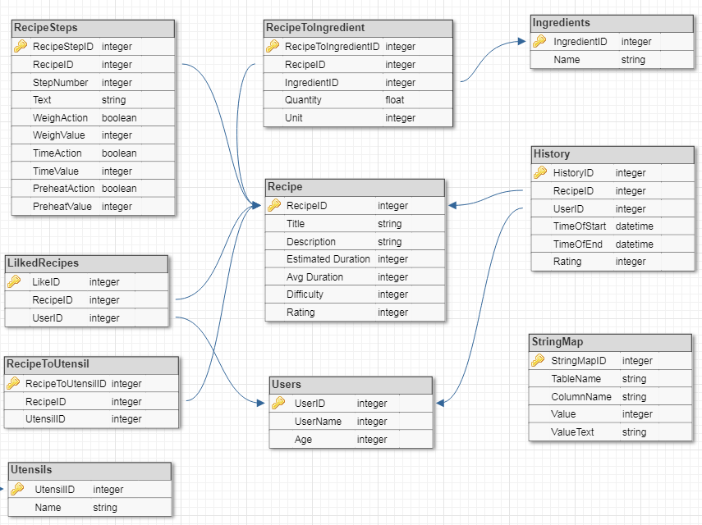
Database Design
Notes:
Jason
As you can see, our database design is very concise.
In the middle we have the recipe table, which stores the high level information of a recipe. Then at the top we have the recipe steps for execution, the lookup table for ingredients and the ingredient table. At the bottom we have the users table, where a user can have a list of favorite recipes. Finally, we have the History table which can aggregated in two ways. Either we can collect the history of a specific user, or the history of a specific recipe. Due to Django’s ease of use, we are planning on expanding our design and adding keywords to recipes as well as potential ingredient replacements so if the user is out of an ingredient the app can suggest a substitute.

Slide 37
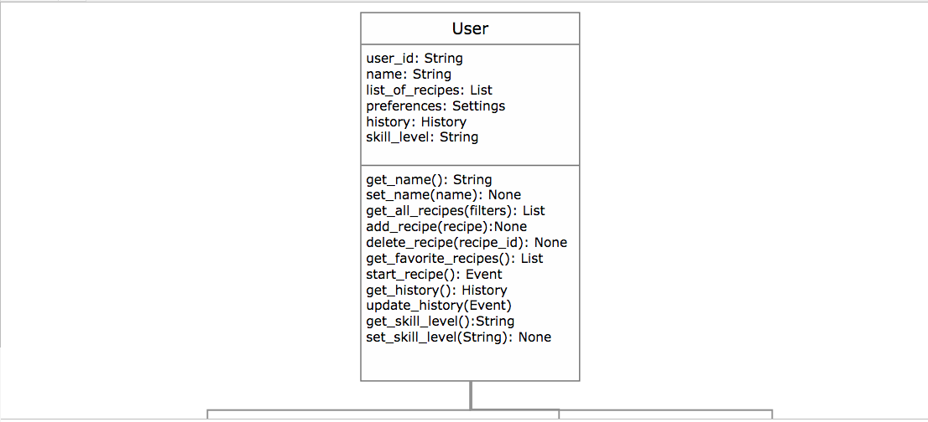
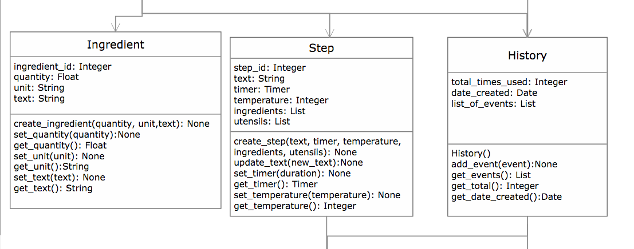
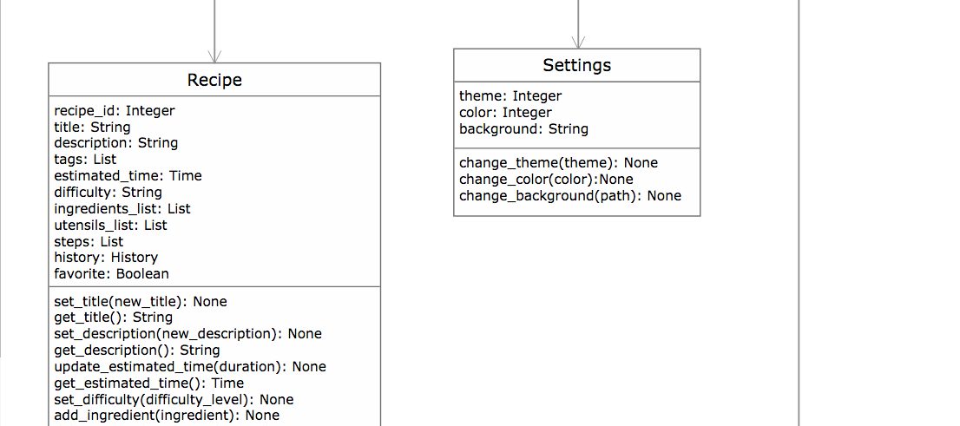
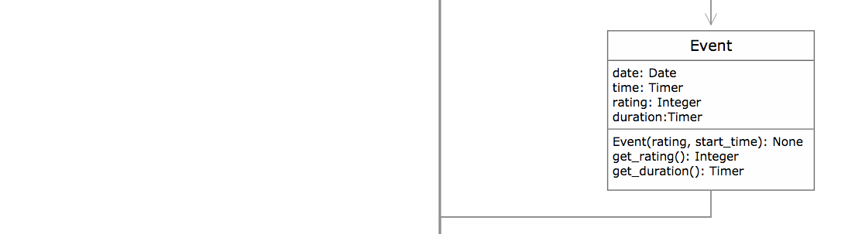

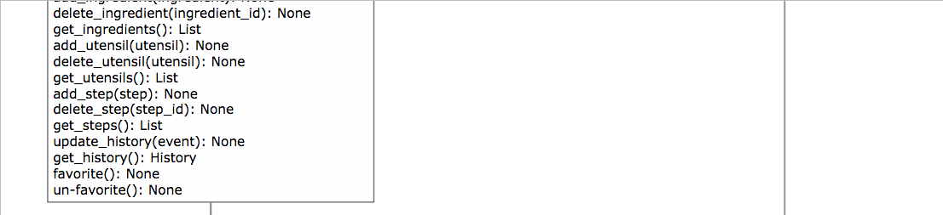
Software Design: Class Diagram
Notes:
Jason API functionality Gera and Jason?
Functionality - For the functionality of the API, we ensured that all of the data tables have the ability to retrieve and update. We also have the ability to send commands to execute recipes and send commands to the scale.

Slide 38
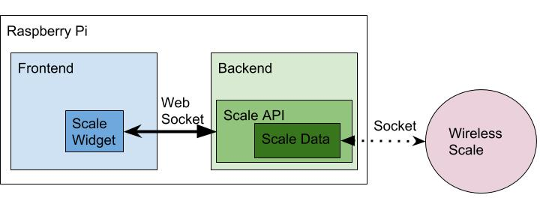
Software Design: Wireless Interface to Scale
WiFi enabled scale
Communicates with the Raspberry Pi via a socket
Django Channels on top of Django
WebSocket used to send data to the frontend
Notes:
Jason
In order for our scale to interact with our application, we will use several layers of communication. The first layer is the WiFi enabled scale communicating with our Raspberry Pi via a socket. Since the scale does not have it’s own display, the only way for us to show them the weight of the scale, we have to display it on the front-end. Therefore, this is an important case for optimizing for speed. Typically, in web servers you can’t have communication prompted from the back-end, it has to be prompted from the client side. So the original solution we had was to write the current scale value to the database, or a file, and then have the client continuously prompt for the current value. We feared that this wouldn’t be fast enough due to several layers of overhead. In order to solve this issue we will be using Django Channels, which takes Django and adds an asynchronous layer on top of it. Django Channels allows us to have functions in the back end persist to communicate with the scale. Finally, Django channels will enable us to use WebSockets where we will be able to forward the stream of data from the scale to the front-end.

Slide 39

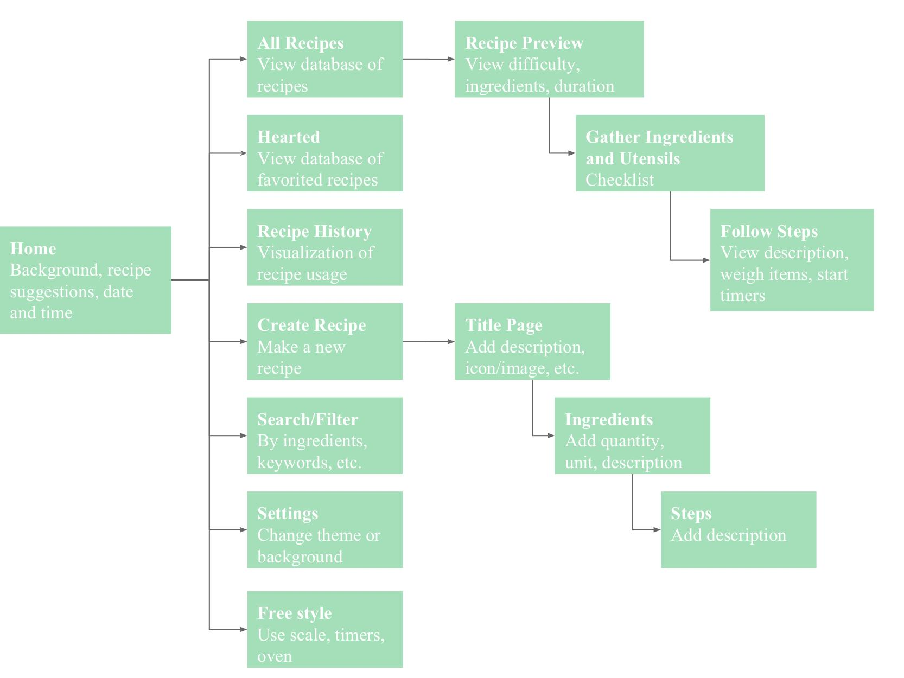
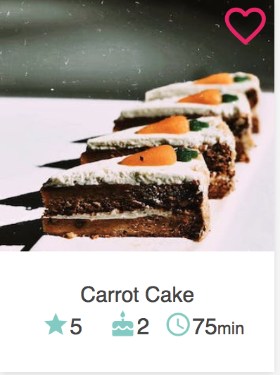
Software Design: UX Flow
Notes:
Here is the flow for the UX. As soon as the user opens the home screen, they are presented with 3 recipe suggestions that are optimized to their preferences. From here, the user can start one of those suggested recipes, create a recipe, or search recipes by name or their favorites. When a user clicks on a card, they can either favorite it, edit it or start that recipe. Besides the main functions, the user can log out, and change the color theme.
Add progress

Slide 40
Software Challenges
Wifi Communications
Limited processing power and memory on the raspberry PI
reduce image quality
remove animations
minimize js and css files
Resolution of the touch foil - larger buttons and UI features
Notes:
1.GERA
2. As you saw in the previous slides, the scale integration is quite complicated and have several layers of communication and since we have not implemented it we do not know the speed that the values will be able to update on the screen.
3.Miguel Another issue we currently have, is that the tv monitor is causing noise in the touch foil. So we need to figure out the distance to properly space the monitor from the touch foil, while still being contained in our
4.Edwin
The television that I personally donated to our project is too bulky for the table chosen. We are at a crossroads where we either get a slimmer TV from Walmart or widen the kitchen carts dimensions.

Slide 41
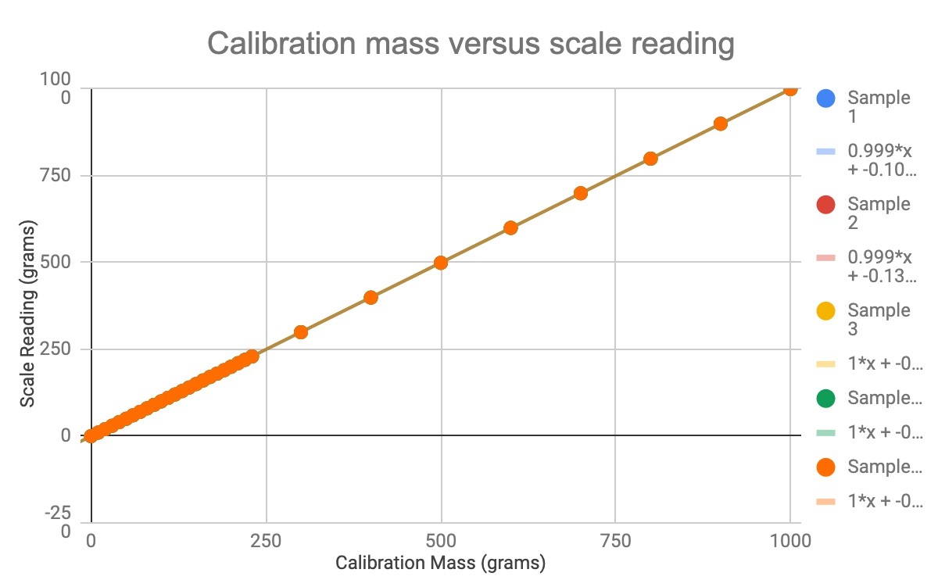
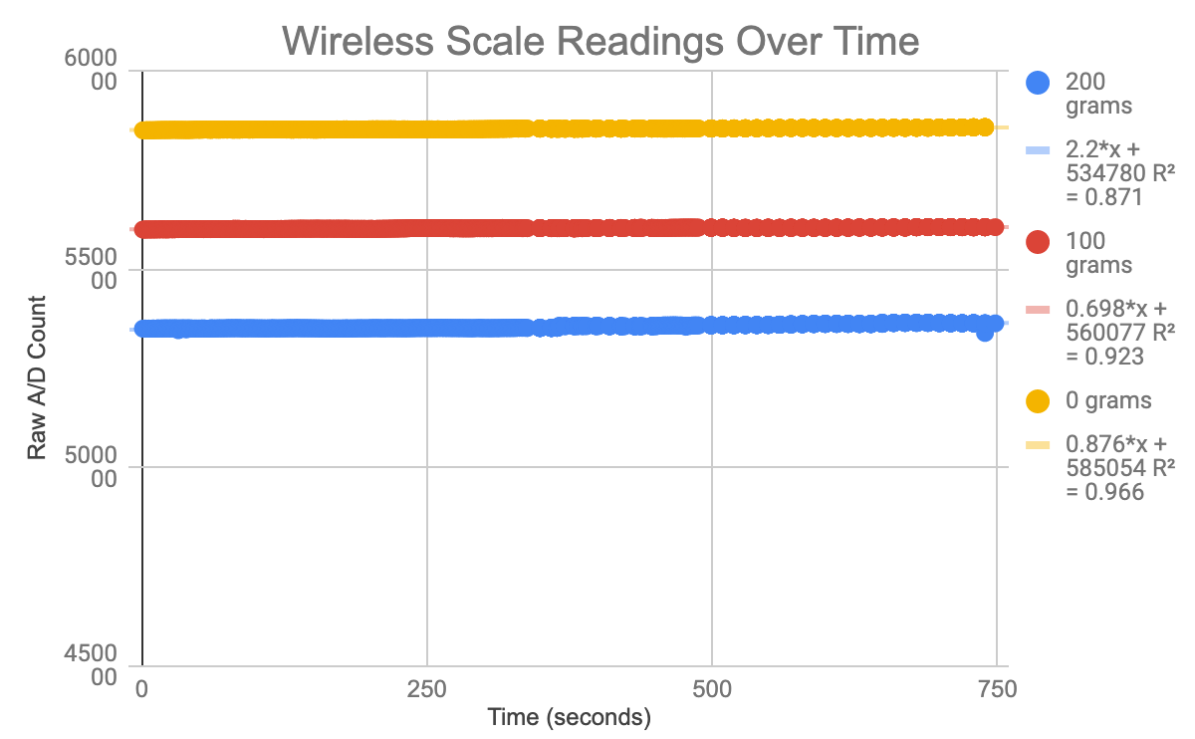
Testing
# | Specification | Target | Actual Value
1 | Diagonal Display Size | ≥30” | 32”
2 | Touchscreen Multi-touch Capability | ≥ 2 touch points | 8 touch points
4 | Scale Accuracy | ≤ 5g | ±0.39 grams
5 | Touch response time | ≤ 100ms | 10ms *
7 | Countertop Diagonal | ≥ 35” | 37.2”
8 | Total Prototype Cost | ≤ $2000 | $347.95
Scale Readings vs Calibration Masses
*datasheet value
Scale Readings over time

Slide 42
Suggestions for Future Improvements
Use microprocessor with built in wifi capability
Use more powerful single board computer
Implement recipe suggestions and importation of external recipes through computer vision
Connect to home assistants like Amazon’s Alexa or Google Home
Notes:
Edwin
If we were given more time to dedicate to our project, we would improve upon a few things and even change a few choices.
The ESP-01 would have been switched out for a microprocessor with built in wifi capability
Used a more powerful single board computer to process our web app
Implemented some sort of external importation of recipes through computer vision
Finally, we would try to connect with home assistants like Amazon’s Alexa and Google Home

Slide 43
Budget
Part | Total Cost | Unit Cost | Our Unit cost
Monitor | $0 (donated) | $109 | $0 (donated)
Kitchen Cart | $0 (donated) | $159 | $0 (donated)
Raspberry Pi 3 b+(kit) | $80.00 | $80.00 | $80.00
Load Cells | $31.96 | $7.99 | $7.99
Tempered Glass | $136.00 | $68.00 | $68.00
Touch foil | $240.00 | $120.00 | $120.00
ATMEGA328p | $19.60 | $1.96 | $1.96
HX711 A/D Converter | $24.00 | $5.00 | $5.00
PCB | $80.00 | $23.00 | $23.00
Wifi module | $26.00 | $4.00 | $4.00
Misc. Electronic Components | $140.00 | $10.00 | $10.00
Wood, screws, etc | $250.00 | $50.00 | $50.00
Total | $1,027.58 | $637.95 | $369.95
Proposed budget of $2000
Self funded, wanted to minimize cost
Notes:
Miguel
Add adjusted budget

Slide 44
Group Member Responsibilities
 | Jason | Gera | Miguel | Edwin
Hardware Design |  | Primary |  | Primary
Software Design | Primary | Primary | Primary
Front End Implementation | Primary | Primary | Primary
Back End Implementation | Primary | Secondary | Secondary
Embedded Software | Primary | Primary | Secondary | Secondary
Manufacturing/ Hardware Assembly |  | Secondary |  | Primary
PCB |  | Primary |  | Primary
Communications Development | Primary
Notes:
Edwin
My role was primarily in hardware design and PCB development

Slide 45
Questions?

Slide 46
Demo

Slide 47
References
https://www.electroluxgroup.com/en/3-trends-from-smart-kitchen-summit-that-will-reinvent-the-cooking-journey-25743/
https://infographicjournal.com/the-smart-kitchen-of-the-future-is-here/
[5]Nema, “A Brief Comparison of NEMA 250 and IEC 60529,” NEMA - Setting Standards for Excellence. [Online]. Available: https://www.nema.org/Standards/Pages/A-Brief-Comparison-of-NEMA-250-and-IEC-60529.aspx#download. [Accessed: 27-Nov-2018].
[6] NASA TECHNICAL STANDARDS: SOLDERED ELECTRICAL CONNECTIONS. (2018). [ebook] Available at: https://nepp.nasa.gov/docuploads/06AA01BA-FC7E-4094-AE829CE371A7B05D/NASA-STD-8739.3.pdf [Accessed 15 Nov. 2018].
[7] "Google JavaScript Style Guide", Google.github.io, 2018. [Online]. Available: https://google.github.io/styleguide/jsguide.html. [Accessed: 30- Nov- 2018].

